Slide 1


Autoencoder-Based Deep Learning Framework for Network Intrusion and Anomaly Detection
MLA0408 – Deep Learning
Presented by:
HARESH KUMAR N L – 192425009
JANANI V – 192425053
KUMARAN M - 192525022
LOGESH S – 192525023

Slide 2
INTRODUCTION
Overview of the Project
Computer networks are the backbone of modern communication, supporting services such as banking, healthcare, education, cloud computing, and online businesses. As network usage increases, cyberattacks like malware, phishing, denial-of-service (DoS), and unauthorized access have become more common. This project uses a Deep Learning-based Autoencoder to learn normal network traffic patterns and detect abnormal activities (anomalies), helping to identify potential cyber threats and improve network security.
Purpose of the Project
To develop a deep learning-based network intrusion detection system using an Autoencoder.
To learn normal network traffic patterns and identify abnormal behavior.
To detect both known and unknown cyberattacks through anomaly detection.
To improve the accuracy and reliability of network intrusion detection.

Slide 3
OBJECTIVE
Goals:
Develop a deep learning-based Network Intrusion Detection System (NIDS) using an Autoencoder.
Learn and model normal network traffic patterns.
Detect abnormal or malicious network activities through anomaly detection.
Problem Statement:
With the rapid growth of computer networks and internet services, cyberattacks such as malware, phishing, denial-of-service (DoS), and unauthorized access have become increasingly common. Traditional intrusion detection systems mainly rely on predefined attack signatures, making them ineffective against new and evolving threats. Therefore, an intelligent system is required to automatically learn normal network behavior and accurately detect suspicious activities using deep learning.
Expected Outcomes:
A trained Autoencoder model capable of learning normal network traffic patterns.
Accurate detection of abnormal or malicious network activities.
Detection of both known and previously unseen cyberattacks through anomaly detection.
Improved intrusion detection performance with reduced false positives.

Slide 4
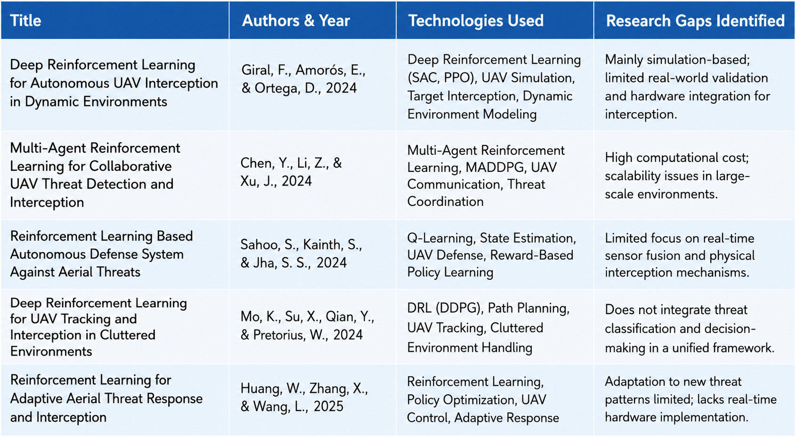
LITERATURE REVIEW

Slide 5
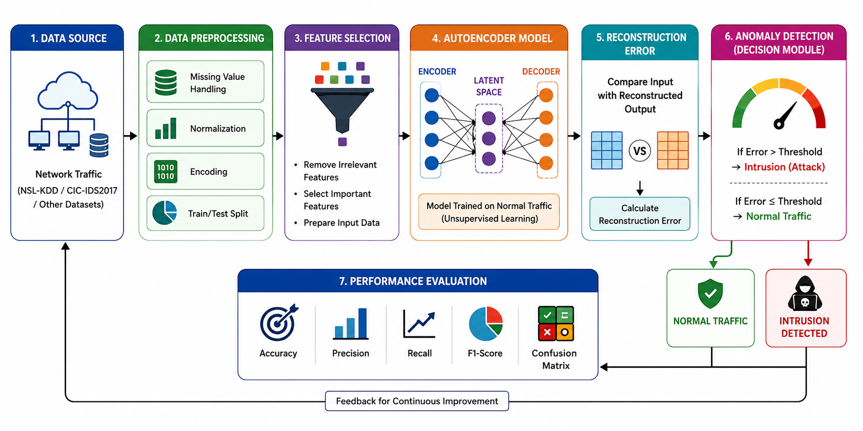
ARCHITECTURE DIAGRAM

Slide 6
LIST OF MODULES
Module 1: Data Collection and Preprocessing
Module 2: Autoencoder Model Development
Module 3: Anomaly Detection and Performance Evaluation
Module 4: System Deployment and Visualization

Slide 7
REFERENCES
G. E. Hinton and R. R. Salakhutdinov, “Reducing the Dimensionality of Data with Neural Networks,” Science, vol. 313, no. 5786, pp. 504–507, 2006.
Y. LeCun, Y. Bengio, and G. Hinton, “Deep Learning,” Nature, vol. 521, no. 7553, pp. 436–444, 2015.
M. Tavallaee, E. Bagheri, W. Lu, and A. A. Ghorbani, “A Detailed Analysis of the KDD CUP 99 Data Set,” Proceedings of the IEEE Symposium on Computational Intelligence for Security and Defense Applications (CISDA), 2009.
I. Sharafaldin, A. H. Lashkari, and A. A. Ghorbani, “Toward Generating a New Intrusion Detection Dataset and Intrusion Traffic Characterization,” Proceedings of ICISSP, pp. 108–116, 2018.
A. H. Lashkari, G. D. Gil, M. S. I. Mamun, and A. A. Ghorbani, “Characterization of Tor Traffic Using Time-Based Features,” Proceedings of ICISSP, 2017.
J. An and S. Cho, “Variational Autoencoder Based Anomaly Detection Using Reconstruction Probability,” Special Lecture on IE, vol. 2, no. 1, 2015.
T. N. Kipf and M. Welling, “Semi-Supervised Classification with Graph Convolutional Networks,” arXiv preprint arXiv:1609.02907, 2017.

Slide 8
Thank You!

